Slide 1


Cancer Reporting from laboratory information systems (LIS) to state cancer registries “ Final Project presentation“
FHIR MDT Team
Michael Schepens, Matt Powell, Ken Nguyen, X. Sheldon Gu, Hasti Ghabel
December 4th, 2016
Professor
Dr. Mark Braunstein
Mentors:
Sandy Jones & Paula Braun
Introduction to Health Informatics - 6440

Slide 2
Outline
Introduction
Problem
Goal
Audience
Research
Design
Methods
Innovation & Solutions
Functionality & Demo
Usability
Benefits
Final Report – Gantt Chart
Conclusions

Slide 3

Introduction
The cancer data is entered into Laboratory Information System (LIS).
The cancer report addresses details on College of American Pathologies (CAP) Cancer Protocols and electronic Cancer Checklists (eCCs) Template.
Problem
Lack of standardized system for laboratory reports to central Cancer Registry causes the procedure developments to capture cases directly from each laboratory.
Incomplete data collection causes missing statistics and research.

Slide 4

Introduction
Goal
Develop a tool that can render CAP Cancer Protocols and eCCs Templates into FHIR Structure Data Capture (SDC) compliant forms and create the website that displays the FHIR HL7 structured Questionnaire, which receives the Laboratory Technician responses and provide Questionnaire Response XML data based on FHIR HL7 standards.
Audience
Laboratory technicians, who process cancer diagnosis and submit required case details to State Cancer Registry.

Slide 5
research
Working with our mentors from the Center for Disease Control (CDC), Sandy Jones and Paula Braun, to better understand the goals of the project, workflow and technical design.
Our mentors provided us sample documentation and source material to learn FHIR HL7 standard Questionnaire and Questionnaire Response structure (http://www. hl7.org) .
We focused on two cancer Questionnaires, Lung and Adrenal.
Studied and Learned about transmitting XML data to HTML using XSLT.
Used Altova Style Vision tool (https://www.altova.com/stylevision.html) to validate Questionnaire/Response against FHIR HL7 Questionnaire/Response schema (Tutorials: https://www.altova.com/aot/online-training.html).
Searched on www.healthit.gov to learn about health organization initiatives and its incorporation into our project.

Slide 6
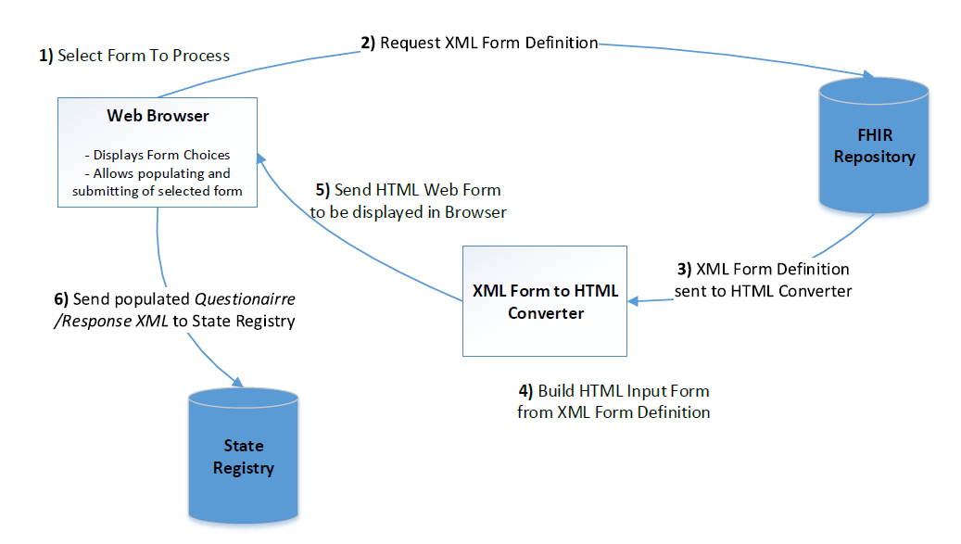
Design
workflow
User selects desired questionnaire form from Webpage
The XML details of selected form is requested from file Repository.
XML data sent to HTML converter.
The system uses XSLT to build HTML format of the form.
The selected Questionnaire appears on web page.
The User fills in the responses on the web form and clicks Submit.
Corresponding XML Questionnaire Response is generated that can be sent to State Cancer Registry.

Slide 7
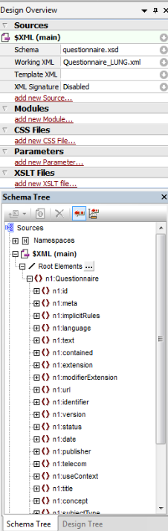
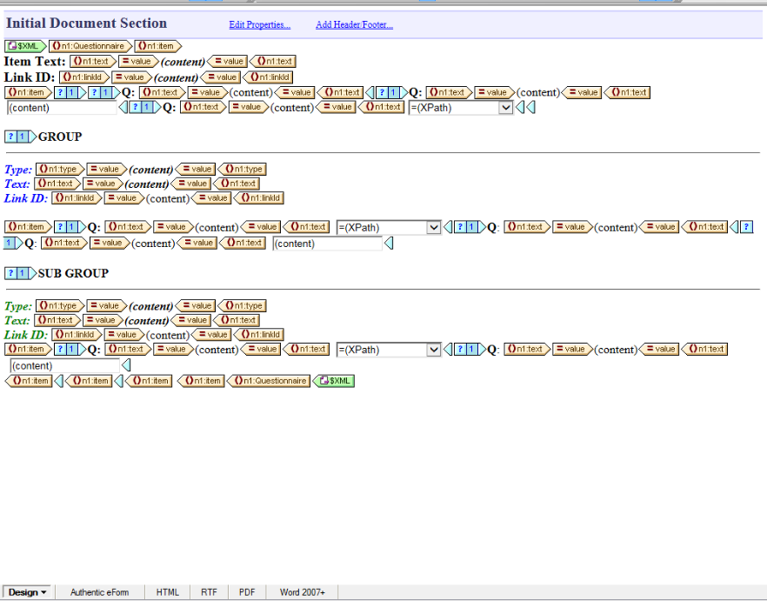
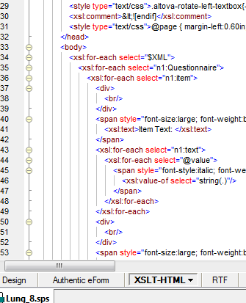
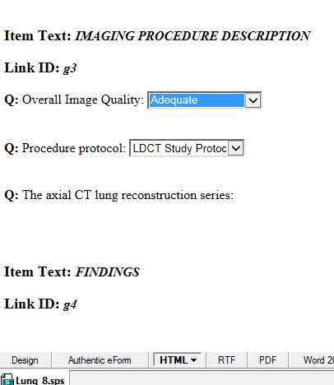
Methods
Experimented with Altova StyleVision tool to generate HTML
Used FHIR questionnaire schema (questionnaire.xsd)
Lung Cancer XML used and development data source
Designed HTML layout within Altova tool
Tool generated corresponding XSLT transformation file
Ultimately, tool proved inadequate and final XSLT was developed by hand
Lung.sps
XSLT
HTML

Slide 8
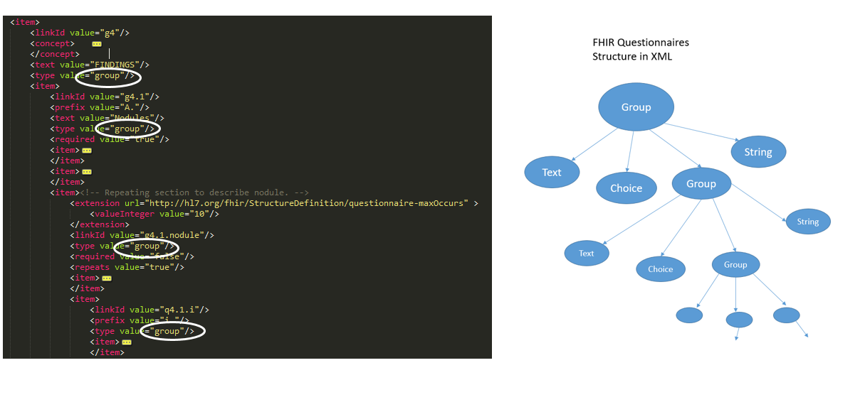
Innovation & solutions
“ XML Structure of FHIR Questionnaire “

Slide 9
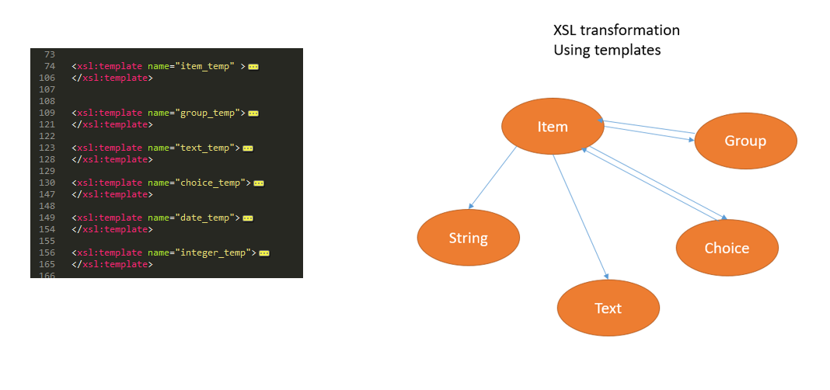
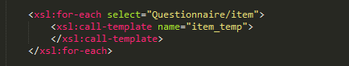
Innovation & solution
“ XSLT – FHIR Questionnaire “

Slide 10
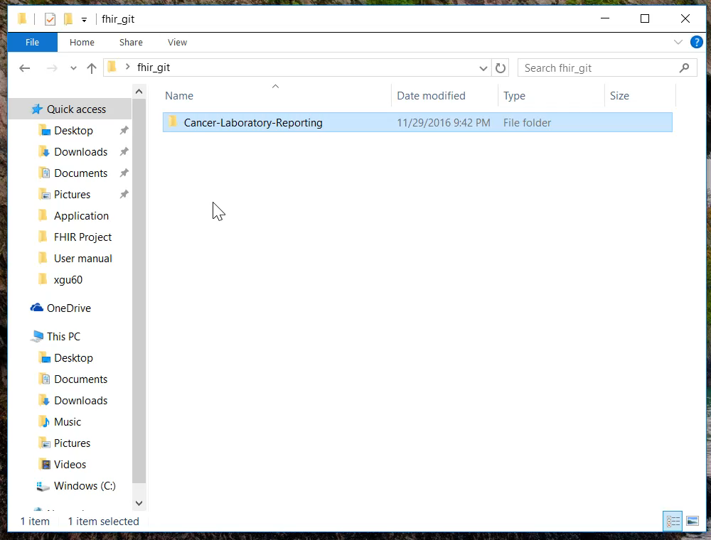
Functionality & Demo

Slide 11
Usability
Benefits
The designed system provides a FHIR Structured Data Capture (SDC) from CAP eCCs, which makes data available in standard format for future use and expedites electronic storage.
Ensuring the central Cancer Registry is aware of all the required cancer instances.
The cancer information acts as a source for research and treatment.

Slide 12
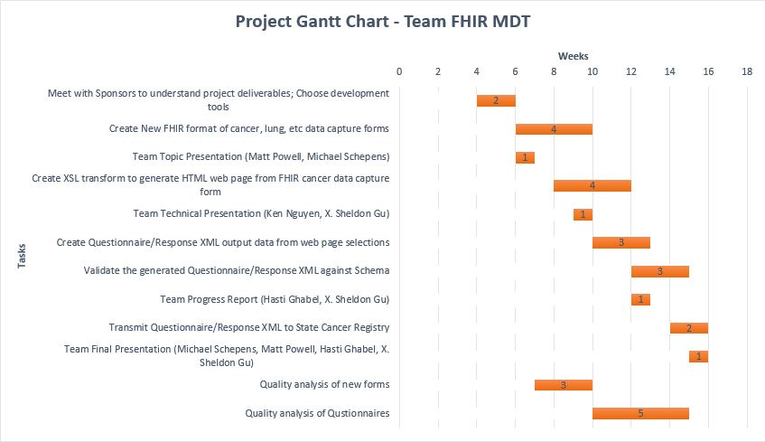
Final Report – Gantt Chart
Roles
Project Manager: Matt Powell
HTML Developer:
X. Sheldon Gu
Server Developer:
Ken Nguyen
Quality Assurance: Michael Schepens
Hasti Ghabel

Slide 13
Conclusions
Our team successfully produced two sample Questionnaires, Lung and Adrenal, compliant with the current FHIR HL7 standard.
We completed a template based XLST transform file that created working HTML web forms for any FHIR HL7 complaint Questionnaire, which allows the user to fill in the selected form online.
We produced the output XML compliant with the FHIR HL7 Questionnaire Response schema.
Our result data is validated to be sent to State Cancer Registry system implementing the same FHIR HL7 standard.

Slide 14
Thank You!

